Slide 1

POWER OF INTENT
Notes:
Further slides reflect one trait of intent with the help of quotes.

Slide 2

vyavasāyātmikā buddhir ekeha kuru-nandana bahu-śākhā hy anantāś ca buddhayo ’vyavasāyinām
Those who are on this path are resolute in purpose, and their aim is one. O beloved child of the Kurus, the intelligence of those who are irresolute is many-branched.

Slide 3

Notes:
Determination

Slide 4

Story of a
Great Archer:
Arjuna

Slide 5
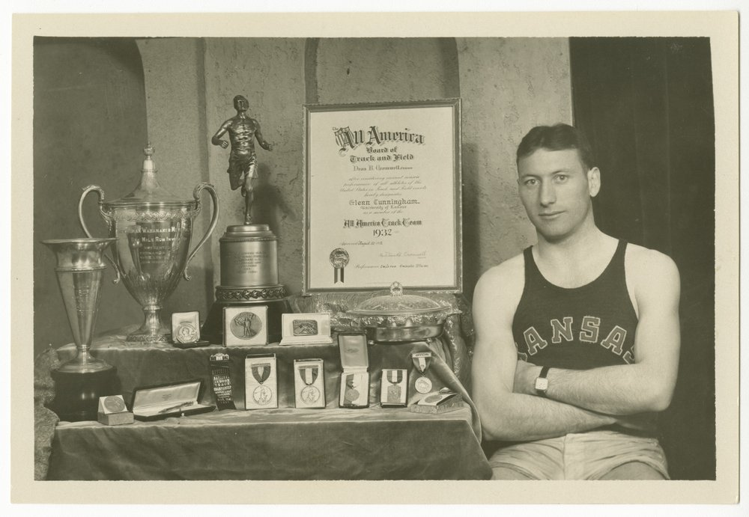

Slide 6

Notes:
Self Discipline

Slide 7

Notes:
Persistence

Slide 8
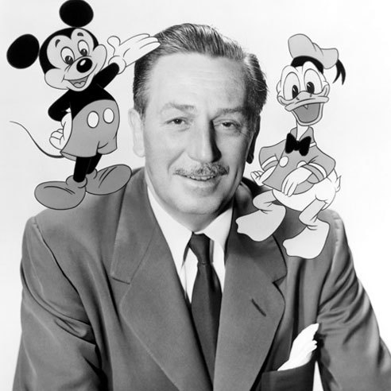
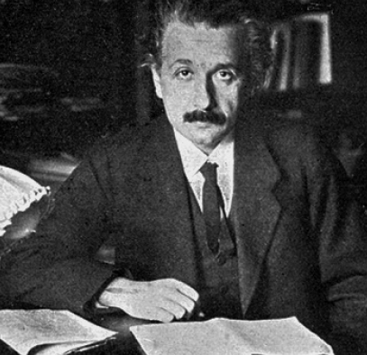



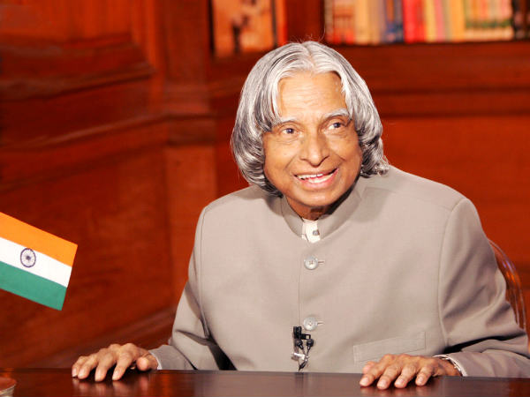

Slide 9


Slide 10




Notes:
Regulation

Slide 11
yuktāhāra-vihārasya yukta-ceṣṭasya karmasu yukta-svapnāvabodhasya yogo bhavati duḥkha-hā
He who is regulated in his habits of eating, sleeping, recreation and work can mitigate all material pains by practicing the yoga system.

Slide 12
BECOME AN ENGINEER OF YOUR OWN LIFE
DESIRED RESULT/GOAL(ASPIRE)
PROCESS(ARCHITECT)
CURRENT REALITY(ASSESS)

Slide 13
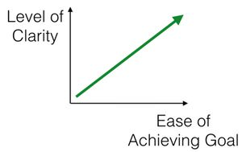
1. CLARITY IS POWER

Slide 14
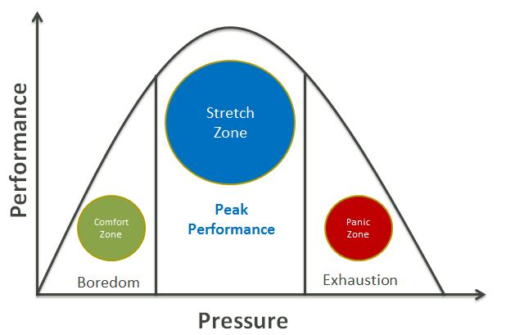
2. KNOW YOUR PERFORMANCE

Slide 15


3. EVALUATE YOURSELF

Slide 16
THANK YOU!!

